Slide 1
Online Provider Update
Conduent
Government Healthcare Solutions

Slide 2
Purpose
The purpose of this workshop is to provide an overview of how to submit an online Provider Enrollment Update request via the New Mexico Medicaid Web Portal.

Slide 3
Objectives
We will review the following:
Advantages of submitting provider updates online
Logging into the NM Medicaid Portal
Available online provider updates
Attaching documents to online provider update requests
Addendum for each upload option

Slide 4
Advantage of Submitting Updates Online
Previously, providers were required to manually complete the MAD 304/Provider Update form and submit to Conduent via US Mail, fax, or in person. This could take up to 10 business days to process.
Submitting update requests online significantly reduces the processing time; within 5 business days to process.
Using the online form will ensure that providers are using the most up-to-date version for update requests. This will reduce delays in processing of the update.

Slide 5
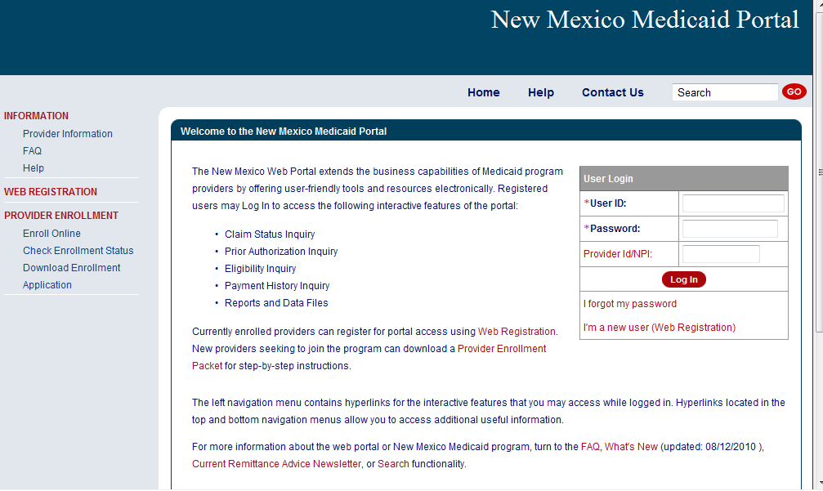
New Mexico Medicaid Web Portal Login
Log in at: https://nmmedicaid.portal.conduent.com/static/providerlogin.htm
Non-Secure Features
Notes:
Speaker Notes: Secure versus Non-Secure functions

Slide 6
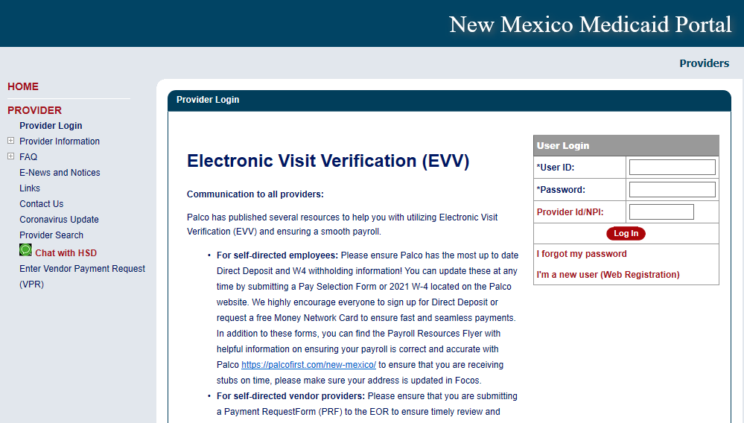
New Mexico Medicaid Web Portal Login
Log in at: https://nmmedicaid.portal.conduent.com/static/providerlogin.htm
Master Administrators (MA) are the only users who can initially access the Provider Update section as well as assign User Rights to others.
Secure Features requires login
If you are not the MA, you can gain access to make updates by contacting your MA and asking them to grant you the Provider Update Security Privilege.
If you need assistance logging in to the NM Web Portal, please contact the CCSC at 1-800-299-7304 or by email at HIPAA.DeskNM@hsd.nm.gov.
Notes:
Speaker Notes: Secure versus Non-Secure functions

Slide 7
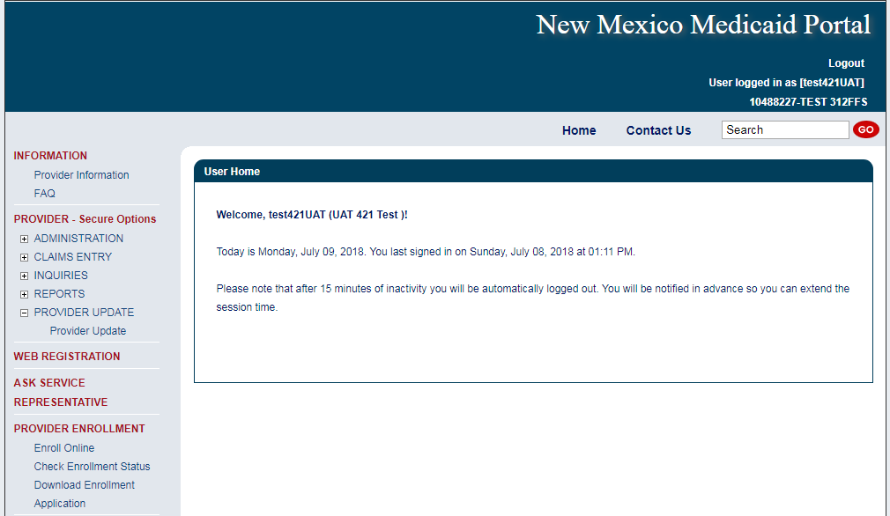
Provider Update
Web Portal Master Administrators and Users with the assigned privilege will be able to access the tool from the left navigation pane after logging in.
Notes:
Select “Provider Update.” Location: PROVIDER (Secure Options) > PROVIDER UPDATE > Provider Update

Slide 8
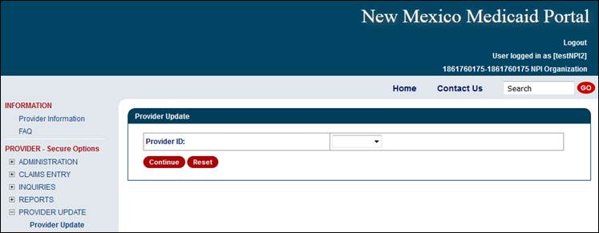
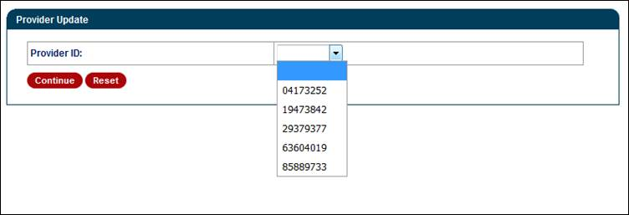
Provider Update Access Continued
Select ‘Continue’ after a provider number has been selected.
Notes:
For Group NPIs – Select the provider number (in which is to be updated) from the drop down option.
Individual NPI – After selecting “Provider Update” from the left window pane; NO option for a drop down selection. It will take you straight to the category section. Examples can be seen in the “Billing and Unrestricted Providers” and “Rendering Providers” sections of this PPT.

Slide 9
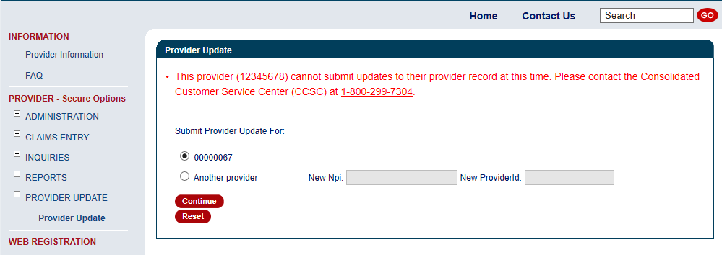
Provider Update Access
Providers may see the following error message to contact Conduent for guidance on moving forward with any provider record changes.
Notes:
The following screen will be shown after clicking the Provider Update option if the update requirements are not met. There are multiple reasons for the message to appear and the best action is for the provider to call the Helpdesk.

Slide 10
Provider Update Access Continued
Upon enrollment with NM Medicaid, providers are classified as billing providers, rendering/servicing providers, or unrestricted providers.
Fee for Service billing, rendering, and unrestricted providers will have separate screens tailored to their application needs for updating purposes:
Billing Provider - A provider or organization that can bill for a claim
Rendering Provider - A healthcare provider who performs the service(s). Also called 'servicing' provider
Unrestricted Provider - Providers that are billing and servicing providers
Active providers or providers with a recently expired license will be able to access the tool.

Slide 11
Billing and Unrestricted Providers
Conduent
Government Healthcare Solutions

Slide 12
Available Updates Online for Billing and Unrestricted Providers
Name
NPI, License, Certificate or Insurance Information
Tax Information and Business Type
Office or Email Address
Add or Term Affiliations
Owner and Manager Information
Backdate or Terminate Enrollment
In some instances, updating certain information may require the submission of an entirely new provider enrollment application. Providers will be notified in such cases.
Notes:
Billing Providers and Unrestricted Provider update options
Note: Insurance is only required with affiliations

Slide 13
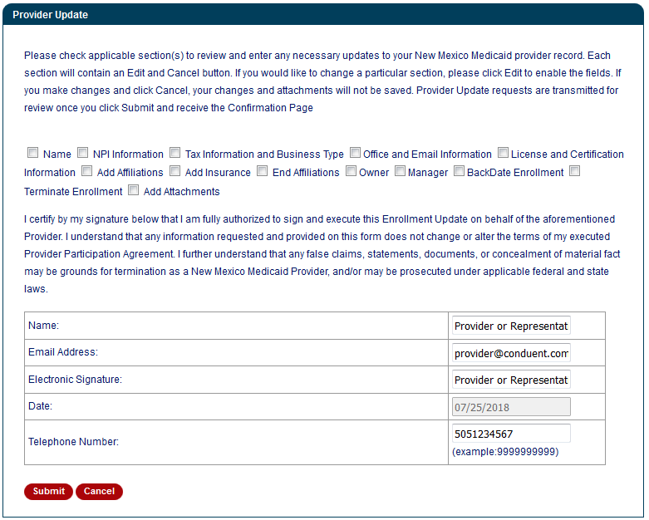
Billing and Unrestricted Providers – Select Update Category
Select all categories that need to be updated.
Please visit the Addendum section of this PowerPoint to learn more on each update option.
These are required fields.
Notes:
Speaker Note: Each option will ask for different information in which is to be updated. More than one categories can be selected per update request

Slide 14
Rendering Providers
Conduent
Government Healthcare Solutions

Slide 15
Available Updates Online for Rendering Providers
Name
NPI, License, Certificate or Insurance Information
Office or Email Address
Add or Term Affiliations
Backdate or Terminate Enrollment
In some instances, updating certain information may require the submission of an entirely new provider enrollment application. Providers will be notified in such cases.
Notes:
Rendering only provider update options
Note: Insurance is only required with affiliations

Slide 16
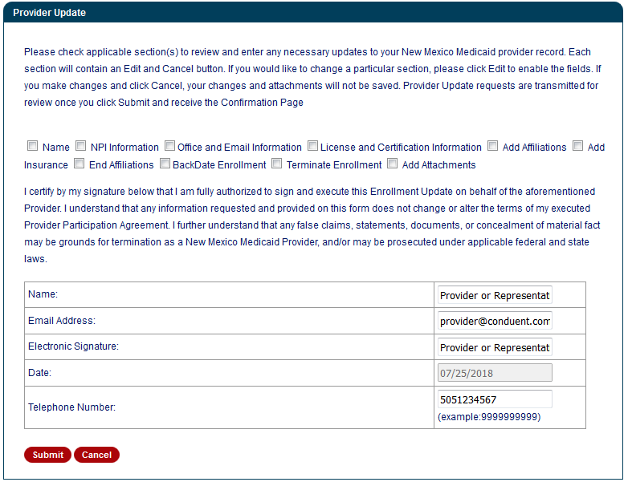
Rendering Providers – Select Update Category
Select all categories that need to be updated.
Please visit the Addendum section of this PowerPoint to learn more on each update option.
These are required fields.
Notes:
Speaker Note: Each option will ask for different information in which is to be updated. More than one categories can be selected per update request

Slide 17
Completing the Request
Conduent
Government Healthcare Solutions

Slide 18
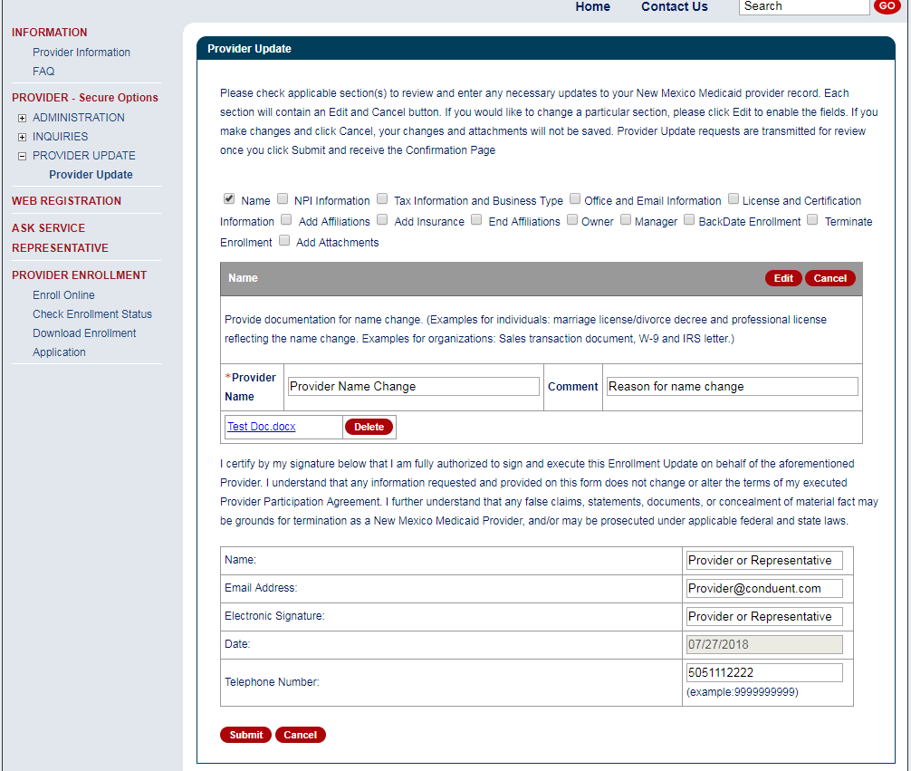
Entering Provider Information
Select ‘Edit’ if you need to add or modify any data.
Add or make changes in the section fields and upload supporting documentation, if required.
Notes:
This upload screenshot is an example of a “Name” update request.
Speaker Note: Edit necessary fields to be updated. Some fields contain data from the provider record (Name, NPI, Tax and Business Type, Office Information, and License and Certification). Other fields are blank and the user can add data (Add and End Affiliations, Owner, Manager, Back date enrollment, and Terminate Enrollment).
Attach pertinent documents using the upload attachment function.
Fill in the certification section after completing all other requested update sections.

Slide 19
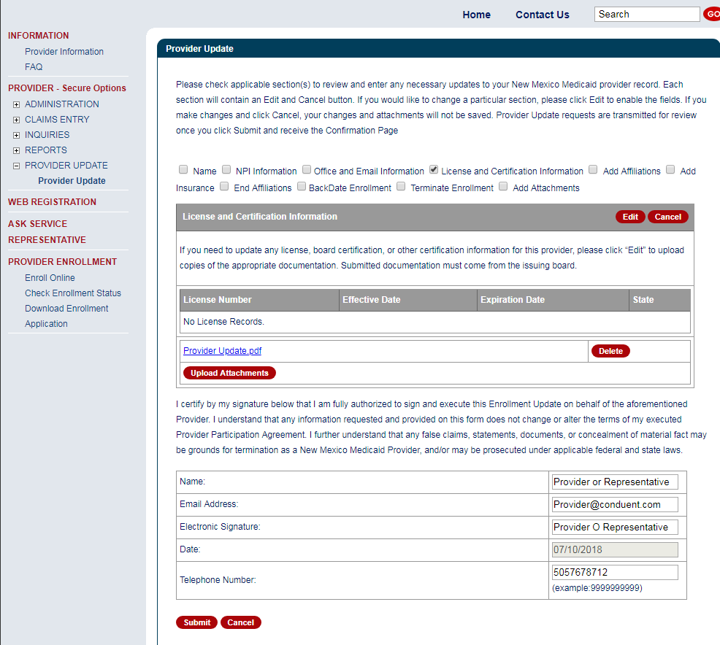
Upload Attachments
Select ‘Edit’ if you need to upload supporting documents.
Then upload supporting documents.
This section must be completed in order to submit the request.
Notes:
This upload screenshot is an example of “License and Certification Information” update request.
Speaker Note: Edit necessary fields to be updated. Attach pertinent documents using the upload attachment function.
Fill in the certification section after completing all other requested update sections.

Slide 20
Submitting or Cancelling the Update Request
Click ‘Submit’ to proceed or ‘Cancel’ to remove changes from the page.

Slide 21
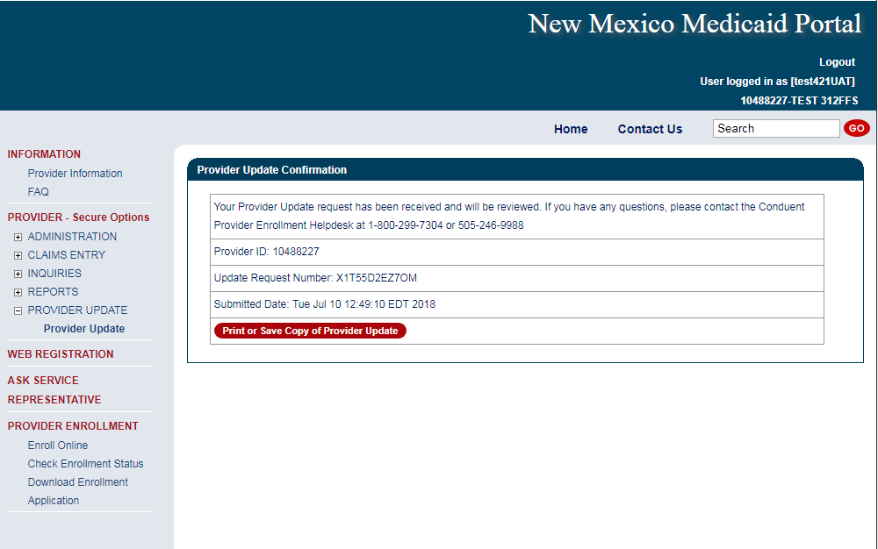
Provider Update Confirmation
Document your Update Request Number for tracking purposes
Notes:
Providers can print or save a copy of the completed 304 form here. The provider’s entry on the page is populated on the MAD 304 electronic form.

Slide 22
Addendum
Conduent
Government Healthcare Solutions

Slide 23
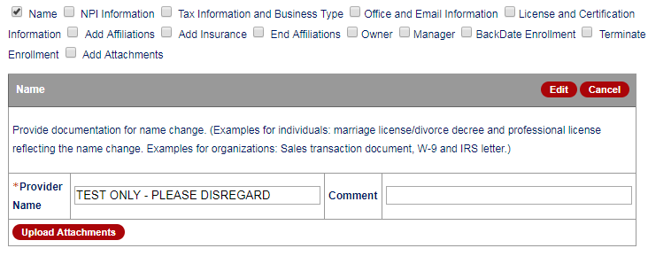
Addendum – “Name”
Available to Billing, Unrestricted, and Rendering Providers

Slide 24
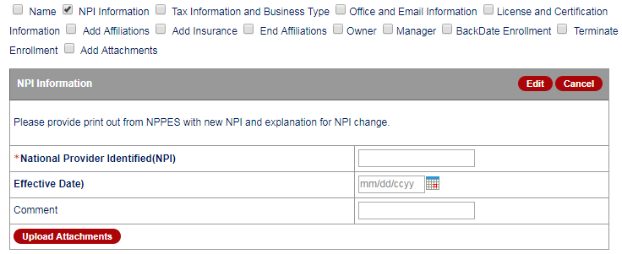
Addendum – “NPI Information”
Available to Billing, Unrestricted, and Rendering Providers

Slide 25
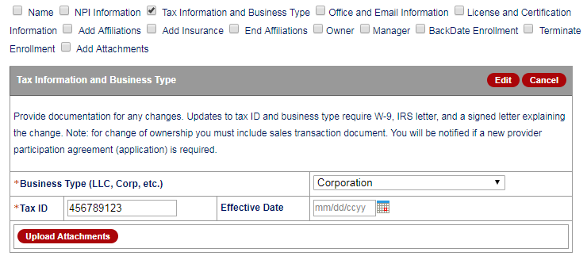
Addendum – “Tax Information and Business Type”
Available to Billing and Unrestricted Providers

Slide 26
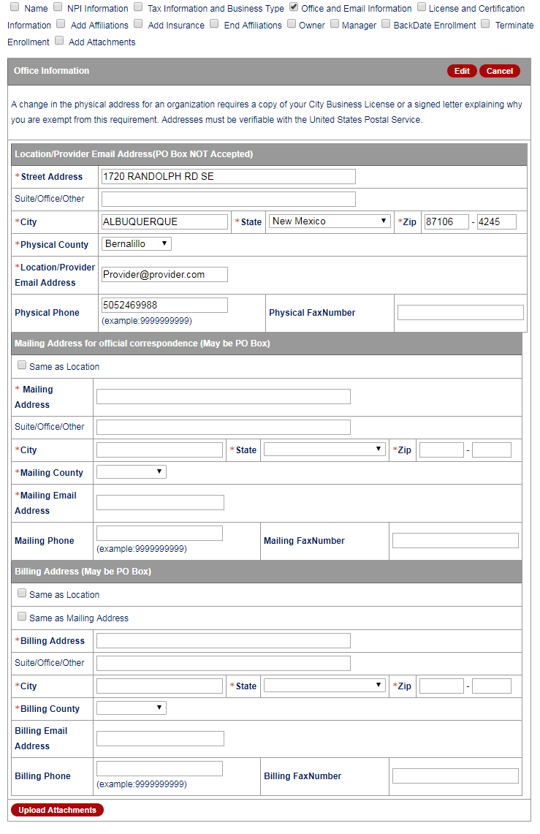
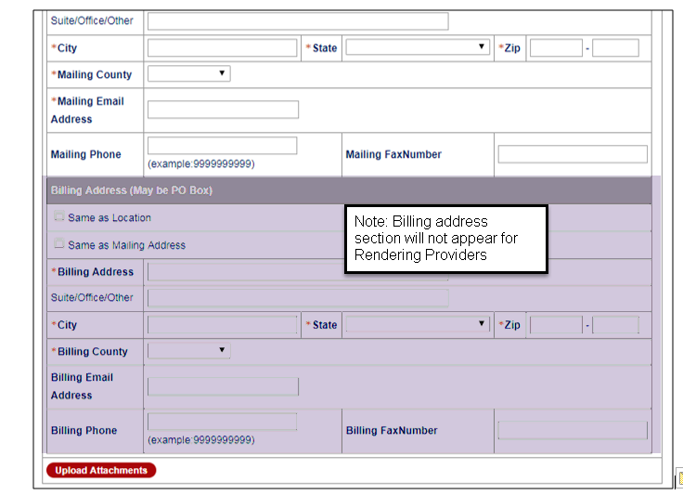
Addendum – “Office and Email Information”
Available to Billing, Unrestricted, and Rendering Providers
Notes:
Billing and Unrestricted providers will have the Billing Address fields. Rendering providers wont.

Slide 27
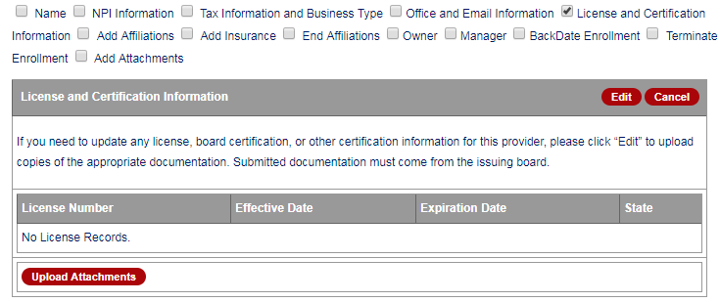
Addendum – “License and Certification”
Available to Billing, Unrestricted, and Rendering Providers

Slide 28
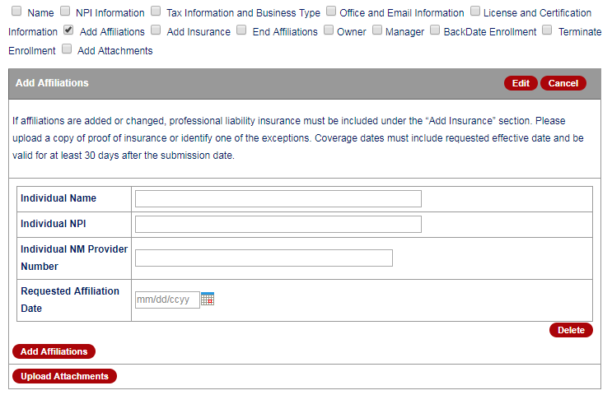
Addendum – “Add Affiliations”
Available to Billing, Unrestricted, and Rendering Providers

Slide 29
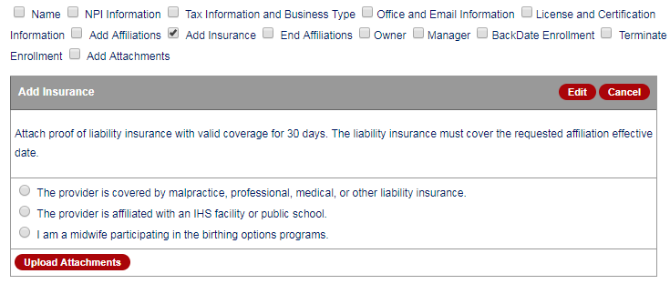
Addendum – “Add Insurance”
Available to Billing, Unrestricted, and Rendering Providers

Slide 30
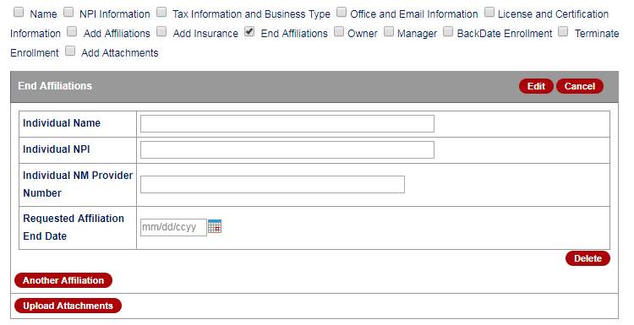
Addendum – “End Affiliations”
Available to Billing, Unrestricted, and Rendering Providers

Slide 31
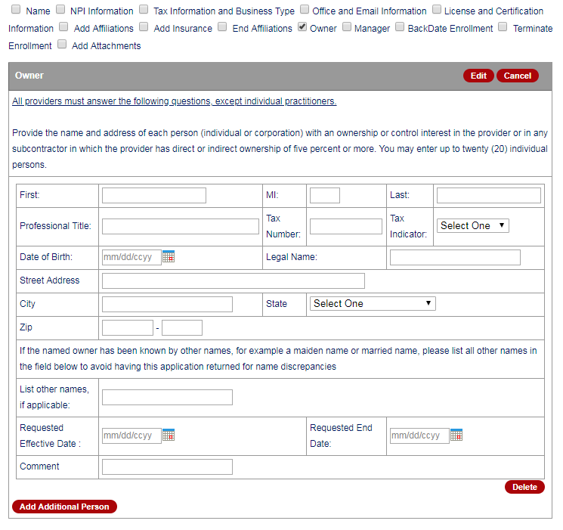
Addendum – “Owner”
Available to Billing and Unrestricted Providers
Notes:
This update is not available to Rendering Providers

Slide 32
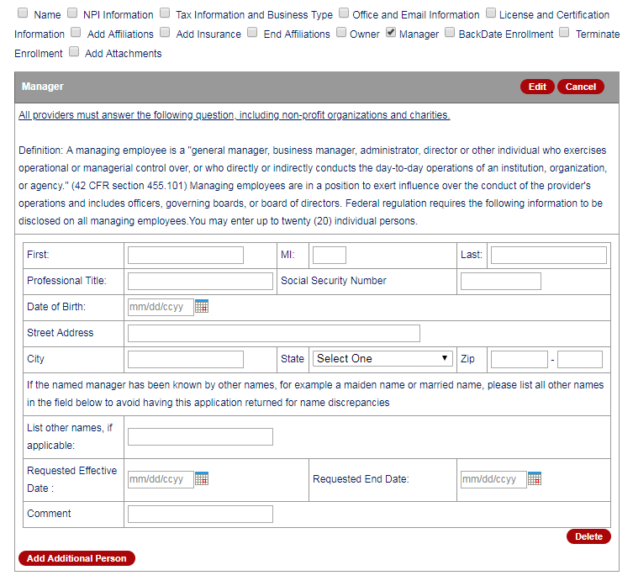
Addendum – “Manager”
Available to Billing and Unrestricted Providers
Notes:
This update is not available to Rendering Providers

Slide 33
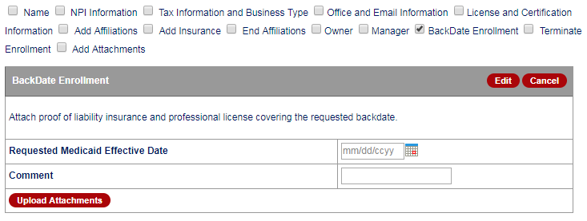
Addendum – “BackDate Enrollment”
Available to Billing, Unrestricted, and Rendering Providers

Slide 34
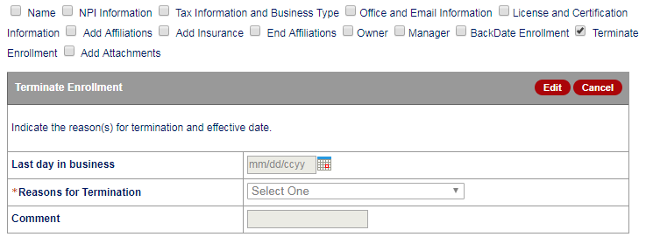
Addendum – “Terminate Enrollment”
Available to Billing, Unrestricted, and Rendering Providers

Slide 35
Addendum – “Add Attachments”
Available to Billing, Unrestricted, and Rendering Providers

Slide 36
New Mexico Medicaid Resources
New Mexico Medicaid Online
Provider Information
Provider Login Screen Notices
Provider E-News Newsletters
Medicaid Provider Relations Call Center
Provider Communication Updates
Provider Field Representative
Provider Webinars
Open Forums and Live Training Sessions
Continued on next page . . .

Slide 37
New Mexico Medicaid Resources Continued
New Mexico Medicaid Portal – https://nmmedicaid.portal.conduent.com/static/index.htm
Claim Inquiries, Eligibility Verification, Electronic Claim Submission, Provider Manuals, E-News
NM Health Care Authority – http://www.hca.nm.gov
Supplements, Memos, Provider Billing Packets and Policy
Medical Assistance Division – PE Program Staff – HSD.PEDeterminers@state.nm.us
Assistance with PE Applications, PE Determinations, MAD 070, PE Training, PE Certification
Consolidated Customer Service Call Center – (800) 299 - 7304
Claim Status, Eligibility, Prior Authorization, Medicaid Updates
Conduent Provider Relations Helpdesk – NMProviderSUPPORT@conduent.com
Claim research assistance and general Medicaid inquiries
Conduent HIPAA Helpdesk – HIPAA.DeskNM@hsd.nm.gov Assistance on NM Web Portal, EDI inquiries, and Online Claim Submission with DDE (Direct Data Entry)
Conduent Provider Enrollment Helpdesk - NMProviderSUPPORT@conduent.com
Provider Enrollment Applications, Forms & Instructions
Medical Assistance Division, Program Rules – http://www.hca.nm.gov/providers/rules-nm-administrative-code/
NMAC for Programs administered by the Medical Assistance Division Yes New Mexico - https://www.yes.state.nm.us/yesnm/home/index Apply, check, update, or renew Medical Assistance (Medicaid) benefits

